Slide 1

Note: The data and information in this document is reflective of a hypothetical situation and client. This document is to be used for KPMG Virtual Internship purposes only.
Sprocket Central Pty Ltd
Data analytics approach
[Division Name] - [Engagement Manager], [Senior Consultant], [Junior Consultant]

Slide 2
Note: The data and information in this document is reflective of a hypothetical situation and client. This document is to be used for KPMG Virtual Internship purposes only.
Agenda
Introduction
Data Exploration
Model Development
Interpretation

Slide 3
Note: The data and information in this document is reflective of a hypothetical situation and client. This document is to be used for KPMG Virtual Internship purposes only.
Introduction
New Customers Analysis
Analyzing the following factors for new customers:
Age distribution criteria
Bike Purchase in 3 years
Job Industry Category
Car owns by the new customer

Slide 4
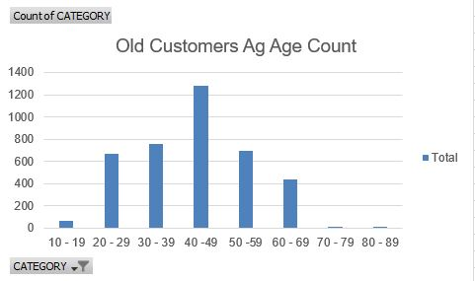
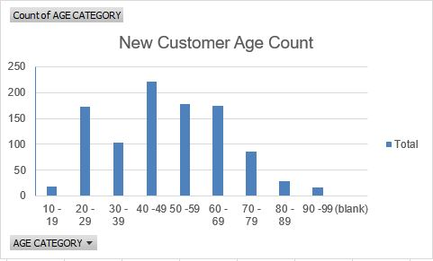
Note: The data and information in this document is reflective of a hypothetical situation and client. This document is to be used for KPMG Virtual Internship purposes only.
Data Exploration
Analysis - Age Distribution
It can be observed from the plots that most of the new customers belong to the age group of 40 – 49 as the same is noticed for the old customer data also. Hence we infer that, people belonging to the this age group are most likely to purchase frequently

Slide 5
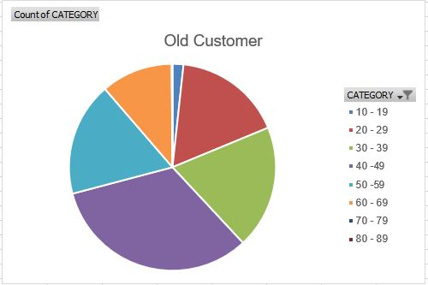
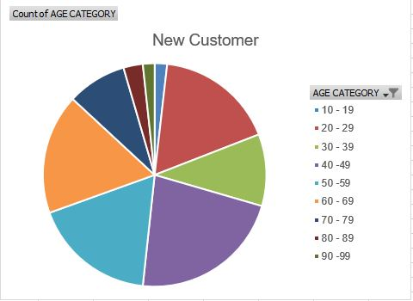
Note: The data and information in this document is reflective of a hypothetical situation and client. This document is to be used for KPMG Virtual Internship purposes only.
Data Exploration
Analysis - Age Distribution
The ratio of purchase has increased in the new customer data for the age group belonging to the range 60 – 69.
The data distribution remains same for the age group of 20 – 29 in both the data.
It looks like the percentages of under 25 years old not really change

Slide 6
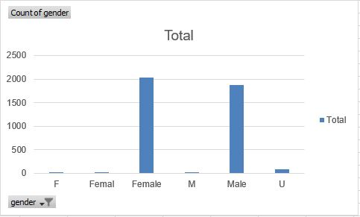
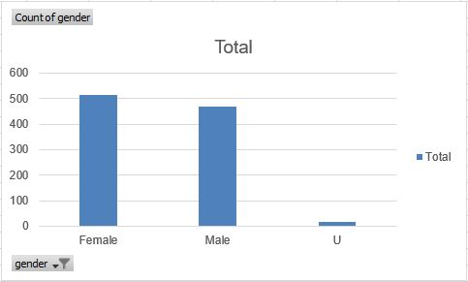
Note: The data and information in this document is reflective of a hypothetical situation and client. This document is to be used for KPMG Virtual Internship purposes only.
Model Development
OLD CUSTOMERS
Purchase History of Bikes (last 3 years)
We can see that around 51% (25,212 bikes) females purchased a bike within the last three years and the male purchase sums up to 47% (23,765 bikes).
The target audience for our marketing and advertising should be inclined to provide focus on females than males.
NEW CUSTOMERS

Slide 7
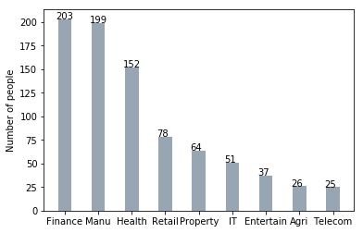
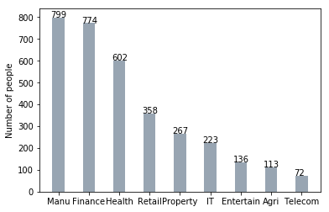
Note: The data and information in this document is reflective of a hypothetical situation and client. This document is to be used for KPMG Virtual Internship purposes only.
Interpretation
OLD CUSTOMERS
Job industry
Most of the new customers belong to the Finance industry and Manufacturing customers still stands among the top two positions.
Rest of the industries seem to remain in the same positions.
NEW CUSTOMERS

Slide 8
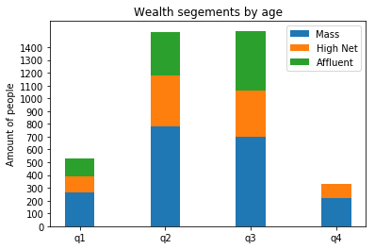
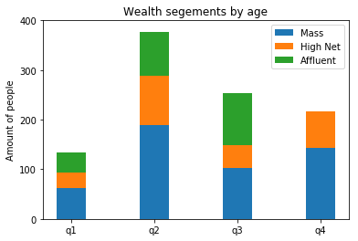
Note: The data and information in this document is reflective of a hypothetical situation and client. This document is to be used for KPMG Virtual Internship purposes only.
Interpretation
OLD CUSTOMERS
Wealth segment
We notice that in all the age groups, the number of Mass Customers remains the highest, so it would be wise to provide extra focus to this area.
The next are of focus should be on High Net Customer Category.
Then followed by the Affluent Customers.
NEW CUSTOMERS

Slide 9
Note: The data and information in this document is reflective of a hypothetical situation and client. This document is to be used for KPMG Virtual Internship purposes only.
Thank You

